Slide 1
2nd March 2010
Objective: to perform an algebraic investigation of different real life sequences
Skills: Absorption and Making Links
By the end of the lesson:
All: complete the investigation
Most: discover the n^{th} term of the sequence
Some: perform their own investigations

Slide 2
Starter
Ten Quick Questions (Series)

Slide 3
Investigations
There are practical situations that require understanding of sequences to solve them.
Can you think of any?

Slide 4
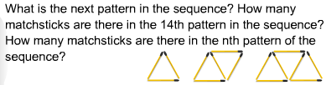
Matchsticks Problem
Do you need to draw them all out to find the 14th pattern in the sequences?

Slide 5
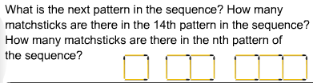
Matchsticks Problem 2

Slide 6
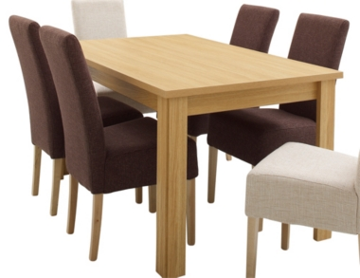
Table Problem
We need to work out how many people they can fit on a 6 seater table when put together. Draw the first 3.
Find the n^{th} term of the sequence?

Slide 7
Number of tables | People Seated
1
2
3
4
5

Slide 8
Solution
Sequence
,
,
n^{th} term is 4n + 2

Slide 9
Different Style
Now try the same question but putting the tables together this way. List the first 5 terms and try and find the n^{th} term.

Slide 10
Number of tables | People Seated
1
2
3
4
5

Slide 11
Solution
,
,
,
n^{th} term is 2n + 4

Slide 12

Handshake Question
If everyone in this classroom had to shake each persons hand, how many handshakes would it take???
(hint: begin by making a sequence for 2, 3, 4, 5 people and see the pattern)

Slide 13
Number of People | Total number of handshakes
1
2
3
4
5

Slide 14
Handshake problem solution
Hopefully you see that it is the triangular numbers which has n^{th} term as
n(n+1)
2
1, 3, 6, 10, 15, 21, 28, 36, 45, 55, 66, ....

Slide 15
Cube Hidden Faces
If we place 1 cube on a table how many hidden faces are there?
If we place 2 cubes together how many hidden faces are there?
Find the sequence up to 10 cubes together?

Slide 16
Number of Cubes | Number of Hidden Faces
1
2
3
4
5

Slide 17
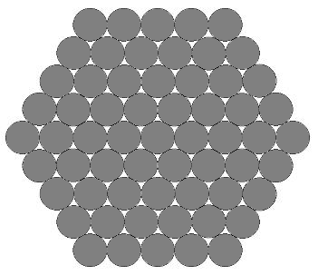
Cables can be made stronger by compacting them together in a hexagonal formation.
Here is a 'size 5' cable made up of 61 strands:
How many strands are needed for a size 10 cable?
How many for a size n cable?
Can you justify your answer?

